Slide 1
Application Modernization
Wireless: xxxx ← MSFTGUEST
Content: http://aka.ms/CleAppModernization
Ryan Berry
Cloud Solution Architect

Slide 2
Resources to Plug
https://askazure.io/ ← Slack channel where you can ‘Ask an Architect’ questions on a topic/idea
http://www.cloudsimplified.io/ ← Webcast on how customers have used Azure to solve problems
Contact:
Ryan.Berry@Microsoft.com

Slide 3
Agenda
09:00–09:30am Registration
09:30-10:30am Migration Strategies: Approaches to migration w/ VMs
10:00-12:00pm Workshop 1: Migrating to VMs on Azure
12:00-12:30pm Lunch
12:30-2:00pm Workshop 2: Migrating to Azure PaaS
2:00-2:15pm Break
2:15-3:15pm Cloud Native: Moving to Containers
3:15-5:00pm Workshop 3: Migrating to AKS
Notes:
We will not have time to cover the last “R” – rebuild in this session.

Slide 4
Workshop Setup
Do we have a subscription to Azure?
If not, you can use register for a trial subscription https://azure.microsoft.com/free
Or ask your instructor if they have other options available for this event
Do you have Visual Studio 2017 installed?
If not, please see https://info.microsoft.com/visual-studio-enterprise-2015-trial.html
or https://developer.microsoft.com/en-us/windows/downloads/virtual-machines

Slide 5
Why modernize?
Reliability and availability - duh
Security – see above
Scale + performance – ‘works in 98052’ isn’t a valid UX
Cost and elasticity – capacity planning but today purchasing
Time to market – 4 months is too long for a VM
Operational overhead – 80% maintenance is a bad place
Future innovation – respond faster

Slide 6
You want to modernize apps also for these reasons
Security
Scale
Innovation
Resolve security challenges
Safeguard reputation
Reach people across multiple platforms
Customize app experiences
Agility
Scale more effectively
Tailor LOB apps
Changing Skillset
Improve extended workflows
Reduce IT Maintenance
Experiment more quickly
Migrate legacy apps
Notes:
Here are some of the situations that the App Modernization Advanced can help with. It’s ideal if you want to:
Speed/Agility – reduce time-to-market and cost ((example includes…)
Drive market innovation and agility with the ability to experiment with different business models quickly and more easily.
Streamline operations by improving extended workflows (i.e., with suppliers and partners).
Scale – customer reach and engagement (example includes…)
Deal with increasingly complex multi-platform environments by delivering innovative and scalable cloud solutions that help organizations engage with stakeholders more effectively.
Security – protect data
Help protect reputation and help make sure services are constantly available with high levels of performance and availability.
Help resolve security challenges that stem from mixing Internet-facing workloads in corporate datacenters.
Innovation – drive innovation and market differentiation (examples include…)
Differentiate yourself with tailored LOB apps.
Customize app and digital experiences for different personas and devices
Developer demographic – skill sets changing
Reduce IT maintenance and improve flexibility by migrating LOB apps originally built on Windows Server 2003 and SQL Server 2005 before end-of-life.
Update legacy applications with more modern, cloud-based solutions that provide greater agility.

Slide 7
The Journey to the Cloud
Migrate
Application Modernization
SaaS
Rehost
Refactor
Rearchitect
Rebuild
Replace
Source: Gartner: “Developing a Public Cloud IaaS Adoption and Migration Framework” published March 2017
Notes:
!Speaker note!: You can introduce the last phase: SaaS, Replace, but we won’t cover that step in detail the rest of the deck.
1) Other options:
- Retain on-premises
Retire
2) SaaS refers to Commercial off-the-shelf (COTS), the purchase of packaged solutions which are then adapted to satisfy the needs of the purchasing organisation, rather than the commissioning of custom made solutions.

Slide 8
The Journey to the Cloud
Migrate
Application Modernization
Rehost
Refactor
Rearchitect
Rebuild
On-Premises
Infrastructure Platform
IaaS
Infrastructure Platform
“lift & shift”
Containers
Container Platform
PaaS/Serverless
Application Platform
Notes:
!Speaker note!: in this session, we will focus on the App modernization. (not going into Replace)
Source: Gartner: “Developing a Public Cloud IaaS Adoption and Migration Framework” published March 2017

Slide 9
Cloud Migration Strategies
Migration and Modernization
Cloud native
Rehost
(lift & shift)
Refactor
Rearchitect
Rebuild
Description
Redeploy as-is to cloud
Minimally alter to take better advantage of cloud
Materially alter/decompose application to services
New code written with cloud native approach
Drivers
Reduce Capex
Free up datacenter space
Quick cloud ROI
Faster, shorter, updates
Code portability
Greater cloud efficiency (resources, speed, cost)
App scale and agility
Easier adoption of new cloud capabilities
Mix technology stacks
Accelerate innovation
Build apps faster
Reduce operational cost
Technologies
IaaS
Containers
PaaS
Move to PaaS
Hosted Databases
Cosmos DB
Blob Storage
PaaS
Serverless
Microservices
Virtual Machines
File Shares
Move to PaaS
Hosted Databases

Slide 10

Choosing migration strategy and technology
Objectives |  |  |  |  |  | Options to consider
 |  | Rehost | Refactor | Rearchitect | Re-build
1 | Deliver new and breakthrough capabilities faster |  |  |  |  | PaaS, Serverless
 | Optimize for developer productivity, build apps faster
2 | Provide multichannel access, including mobile and IoT |  |  |  |  | PaaS, Serverless
 | Enable wider, secure access to applications, support range of devices
3 | More easily integrate with other web and cloud apps |  |  |  |  | PaaS, Serverless
 | Leverage PaaS, increase productivity with Serverless
4 | Enable business agility with continuous innovation |  |  |  |  | PaaS, Containers
 | Increase DevOps agility across teams
5 | Meet scalability requirements of existing apps more cost effectively |  |  |  |  | PaaS, Containers
 | Optimize application architecture for cloud scale
6 | Leveraging existing investments |  |  |  |  | PaaS, Containers
 | Across dev/ops, developer experience, tooling, infrastructure and deployed apps
7 | Free up data center space quickly |  |  |  |  | IaaS
 | Free up or consolidate resources for apps that must reside on-premises
8 | Reduce capital expenditure of existing applications |  |  |  |  | IaaS
 | Switch to pay-as-you-go model, realize better budget forecasting
9 | Achieve rapid time to cloud |  |  |  |  | IaaS
 | Allow migration with minimal architectural impact
Migrate
Modernize
Note: Some of the objective might apply to more than one category of applications

Slide 11
Microsoft’s Own Journey to the Cloud
Roadmap planning
From…
Office servers
Portals and SPS
Any relationship mgmt
Active Source Control & WIT
Data warehouses
Industry standard verticals
From…
Office servers
Portals and SPS
Any relationship mgmt
Active Source Control & WIT
Data warehouses
Industry standard verticals
…To
Office 365
SharePoint Online
CRM Online
VSO
ADL + PowerBI
Best 3rd-party SaaS
~30%
…To
Office 365
SharePoint Online
CRM Online
VSO
ADL + PowerBI
Best 3rd-party SaaS
Retire it, right-size, eliminate environments
Retire it, right-size, eliminate environments
~15%
Use or convert to a SaaS (1st or 3rd party) solution
Use or convert to a SaaS (1st or 3rd party) solution
Expose functionality in existing SaaS/PaaS solution
Convert to Azure PaaS solution
Optimize for and move to Azure IaaS
~35%
~10%
~5%
First to move
Basic web apps
Advanced portals
Any new solutions
Any re-architected solutions
Next to move
High I/O OLTP
Regulatory and high business impact
Hard or costly to Move
HVA Systems
PKI Systems
Legacy source control
No change, lift ‘n shift to IaaS
Remain on-premise
<5%
Azure IT Roadmap
Notes:
It mostly covers systems of record and system of differentiations.
Presentation Notes:
This slide shows the outcome of the portfolio evaluation process. It shows the output and results of portfolio evaluation, and how the vast portfolio is divided up and slated for adoption. It also shows that half of the portfolio consists of custom LOB apps.
Speaker Notes:
After analyzing our portfolio, we’ve determined rough distributions of application placement in the cloud.
As mentioned previously, this has been a great opportunity to retire applications and streamline our portfolio. We see 30 percent of our portfolio here. 1,300 apps, very aggressive about addressing capability duplication.
Retire: Evaluate whether we can retire or consolidate functionality into one app or service line.
Rightsize: IT is good at overprovisioning and underutilizing. This is reflected in utilization rates, and cold/frozen servers. Moving to the cloud is an opportunity to look at performance and capabilities of existing physical servers/VMs, and decide where to land in Azure.
Eliminate environments: Thousands of physical servers and VMs have been eliminated.
Go after cold (< 5% server utilization in 90 days) and frozen (< 20% server utilization in 7 days) assets. Get smart about how we use what we bought.
For sustain apps (no further investment), look to see if app has pre-production environments such as Dev or Test, and turn them off. This can realize a 90% cost savings.
We see 15% of our portfolio being replaced by a SaaS solution (move from Office servers to Office 365)
Adopt commodity solutions, such as Office 365, SharePoint Online, some third-party solutions, as they become available.
Transition functionality from shadow IT to retail solutions.
Complex and customized LOB applications make up 50% of our portfolio. Within that 50%:
35% have been identified as “first to move.” These are basic web apps, or re-architected solutions.
10% have been identified as “next to move.” These are being Moved to IaaS. We are more aggressive than customers, focusing on “what’s moving next?” Don’t hesitate, move apps and functionality, and make it work.
5% have been identified as “hard or costly to move.” They fail, and fail fast.
Some apps have been moved back on-premises. Why?
Azure capabilities need to develop, or need very large VM to make it work.
They can’t meet SLAs, and can’t be remediated.
Proof of concept, for example waiting for internal security reviews, due diligence, and so on.
Less than 5% of apps remain on premises.
Notes on rightsizing
Take the opportunity to rightsize as you go in. Scale up and out. Acquire technical “debt” from legacy apps, which were designed to work in on-premises environments, where latency is low.
Moving to the cloud, some considerations, such as latency, may no longer be an issue in the cloud environment. On the other hand, there may be new issues, such as the speed of light, when workloads are moved further away.
Like an onion, the center is a server. It is unlikely that an enterprise IT app is a single server. Usually multiple servers.
Move one server into public cloud? Adding 50 megaseconds can have an impact. There are upstream and downstream dependencies on service lines. For example, the store experience is an app, sales engine, and fulfillment engine. The move may affect customers, SLAs with business partners, etc.
Start with smallest computing capacity that you can make it work in; it is easier to move to larger sizes if needed.
This is a big cultural change. IT usually overprovisions computing capacity.
You must continue to monitor environments. For example, if writing an app for PaaS, it doesn’t automatically rightsize itself.
Process for approaching complex/customized LOB apps
Expose functionality in existing SaaS/PaaS solution. May have to re-architect or rebuild.
Convert to Azure PaaS solution.
Optimize and perform bulk operation, move to Azure IaaS VM.
No change, lift and shift to IaaS. Move the existing IT footprint to Azure. Re-create/copy to Azure, or move from on- to off-premises.

Slide 12
When to consider
Ideal when your goal is to improve operational efficiencies, and free up data center space
Maintenance apps for which the hardware is not worth additional investment
Compute-intensive applications that are built for parallelism but don't require high-performance interprocess communications (IPC) and have independent datasets, and applications for which load balancing already increases scalability and availability.
Migrate
(Rehost)
Benefits
Drives higher ROI (435% from migration to IaaS). Try our TCO Calculator.
No need to manage data centers
Enjoy flexible and scalable infrastructure
Definition:
Rehosting is also referred to as a "lift-and-shift" migration. In essence, the application is moved into the IaaS environment of a cloud provider while avoiding as many modifications to the system as possible. In this case, you would not be taking advantage of cloud technology such as autoscaling, for example.
Core technologies
VM, VM Scale Set
Source: Gartner IT Glossary.
Notes:
Gartner IT Glossary.
Decision Point for Choosing a Cloud Application Migration Strategy, Gartner. Published: 29 March 2016
Migration Objectives
1-Rehost
2-Refactor
3-Rearchitect
Rapid time to market
Allow migration with minimal architectural impact
Deliver new capabilities/modernization
Reduce the volume of code needed to express a capability
VM
Supporting seasonal scalability requirements more cost effectively
Optimize application architecture for cloud scale
Avoid operating expenses, preserve capital
Switch to pay-as-you-go model, perform better operational budget forecasting
Operational efficiencies
Increase infra agility and maximize organizational resource utilization
Free up data center space
Free up or consolidate resources for applications that must reside on-premises
Leverage existing investments
Across dev/ops skills, experience, tooling, infra, and deployed applications
Provide multichannel access, including mobile and IoT
Enable wider, secure access to the application
More easily integrate with other Web and cloud apps
Increase productivity and leverage mature SaaS

Slide 13
Move any workload or application to Azure
Easy to migrate
Integrated migration tools for both data an apps
Data Migration Assistant
Vast network of partners
Any workloads
Applications
SAP, .NET, Java, Node.js
Virtual machines
Windows Server, Linux
Databases
SQL Server, Oracle, MySQL, DB2
Azure

Slide 14
Workshop 1
Deploying Website on Azure IaaS VMs

Slide 15
When to consider
You want to leverage existing development skills and codebase is paramount
When code portability is a concern.
You prefer a quick way to modernize your apps
Refactor
Benefits
Drive continuous innovation by leveraging built-in DevOps or using Containers.
Easily scale up or down to meet the changing needs of the business
Improved portability and density.
Existing programming models, languages and frameworks that can be easily used and extended.
Fast CI/CD.
De
Definition
Refactoring an application involves some change to the application design, but not wholesale changes to the application code. The application takes advantage of IaaS and potentially PaaS capabilities from the provider while maintaining code strategic to the application's use case.
Core technologies
Containers, container orchestration
DevOps tools
Source: Gartner IT Glossary
Notes:
Speaker note:
Refactor: also referred to as Repacking. This is a phase where no or minimal coding or rearchitecture is required. If you sense audience is a bit confused with Refactor, use Repackage to communicate the characteristics of this phase.
Source: Decision Point for Choosing a Cloud Application Migration Strategy, Gartner. Published: 29 March 2016

Slide 16
Azure Application Services
A cloud app platform for delivering modern enterprise apps across cloud and mobile devices.
Delivered as an integrated offering that delivers features and capabilities from a number of existing Azure services
Enterprise Grade Apps
Fully Managed Platform
High Productivity Development

Slide 17






An end to end Application Platform
Apps
eCommerce
Digital global presence
Custom apps
LOB
API/Services/ISV
Services
Web apps
Web apps for Containers
Logic Apps
Azure
functions
API apps
Notification hubs
Mobile apps
Platform
App Service
Fully Managed Platform • Developer Experience • Enterprise Grade

Slide 18

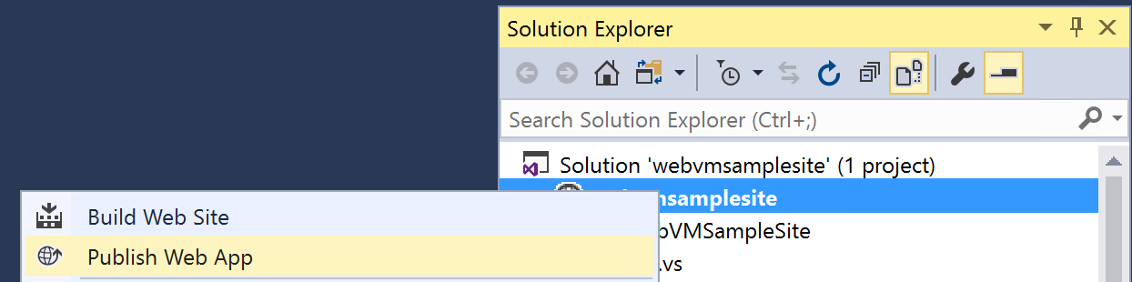

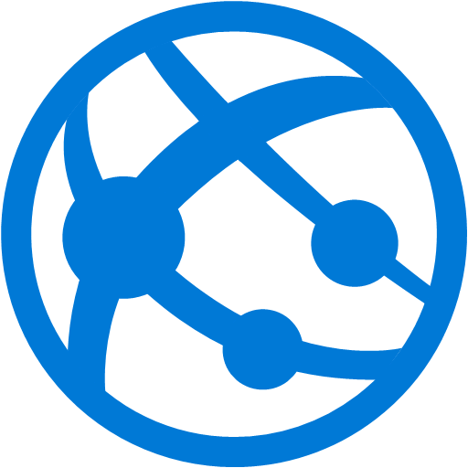
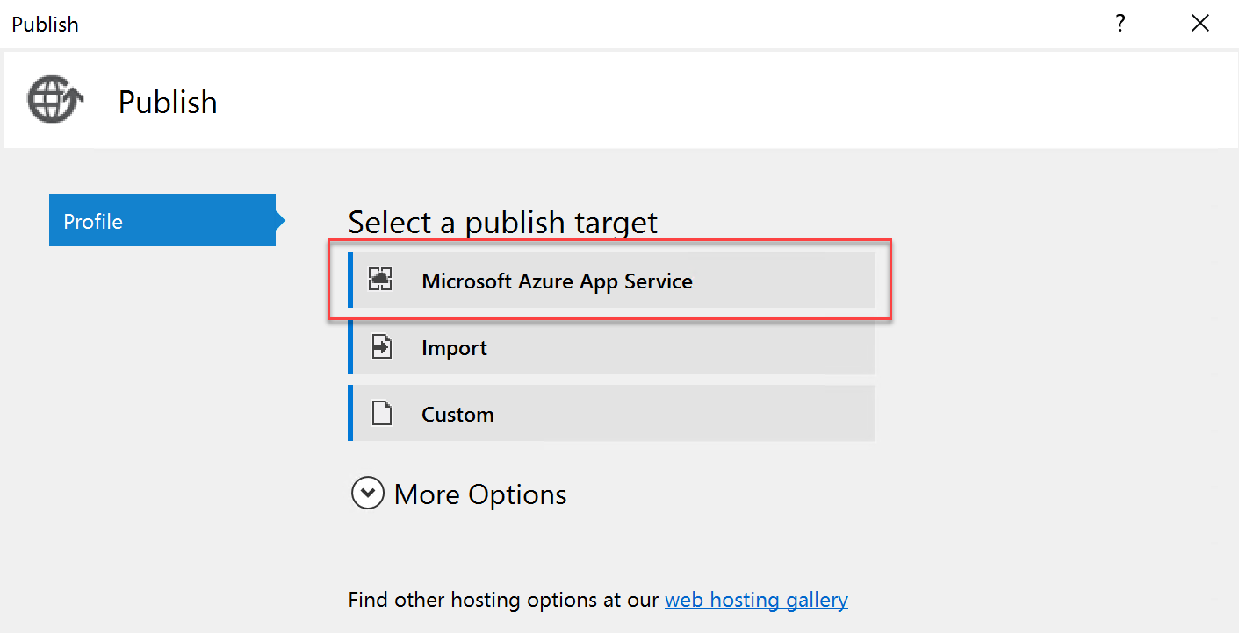
Deploying Code Directly to an Azure Web App
Test
S ame
Dev
Web App

Slide 19

Deploying a Package to an Azure Web App
Similarly, push source code to multiple instances
Production
Package
Package
Production
Dev
Test
Production

Slide 20
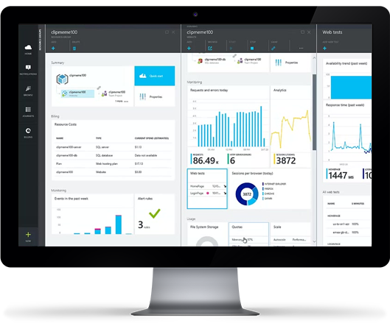
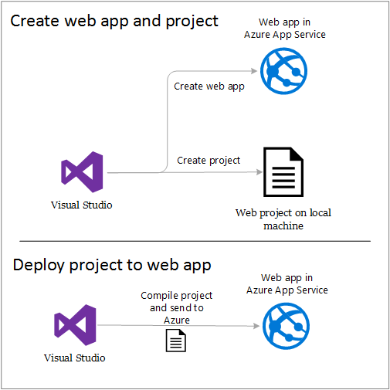
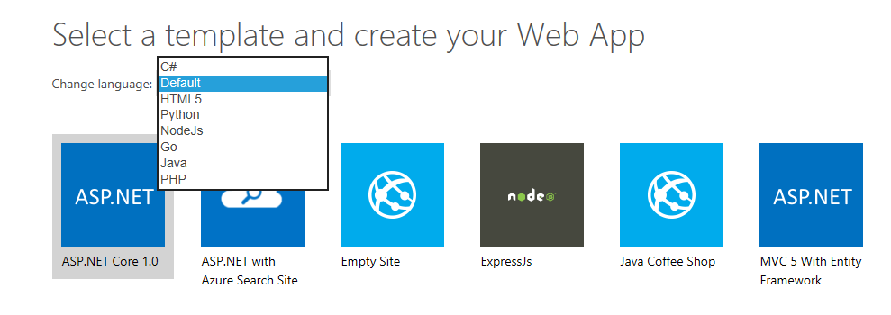
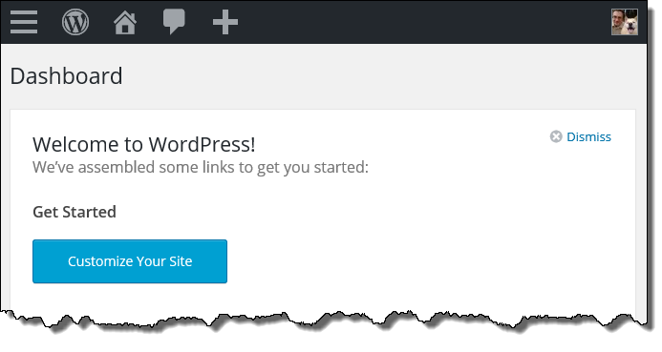
Supported Languages & Tools
Web Apps can be developed in virtually any development language and any toolset, including .NET, PHP, Node.js, Python, Java, Marketplace extensions. Web App development is built into Visual Studio 2015 and up for supported languages.

Slide 21
Workshop 2
Deploying Website on Azure App Services

Slide 22
Rearchitect
When to consider
When apps need a major revision to incorporate new capabilities or take advantage of the cloud-native capabilities.
Benefits
Deliver new capabilities and modernization through modified codebase and a monolithic to micro services architectural revision.
Reduce the volume of code needed to express a capability while still leveraging existing investments.
Agility and scale.
Definition:
Rearchitecting an application for cloud usage enables you to take advantage of technologies such as autoscaling and dynamic reconfiguration. This process will require developer resources to implement and can take significant time to implement.
Core technologies
PaaS, microservices, containers and FaaS
Source: Gartner IT Glossary
Notes:
Source: Gartner IT Glossary
Decision Point for Choosing a Cloud Application Migration Strategy, Gartner. Published: 29 March 2016
Your goal is to minimize cost and risk of the migration and at the same time improve DevOps and introduce newer cloud concepts, such as Containers.
You may not want to make an architecture or code changes to the application, just yet.
Materially alter the application so that you can shift it to a cloud-optimized architecture, making heavy use of cloud-native capabilities

Slide 23
Rearchitect: from monolithic app to microservices
Monolithic application approach
Microservices application approach
1
App 1
3
App 1
App 2
Individually built and deployed
Small, independently executing services
Integrate using published API calls for overall application’s functionality
Fine-grained, loosely coupled application
2
4
Notes:
Enter microservices…
The term “microservice” emphasizes the fact that applications should be composed of services small enough to truly implement a single role. Each has well-defined contracts (API contracts) for other microservices to communicate and share data with it. Microservices must also be able to version and update independently of each other. This loose coupling is key to supporting rapid and reliable evolution of an application. What would have been a single tier of a monolithic application decomposes into many discrete microservices, each independent and isolated.
Graphics for monolithic app:
A monolithic app contains domain-specific functionality and is normally divided by functional layers, such as web, business, and data.
You scale a monolithic app by cloning it on multiple servers/VMs/containers.
Graphics for microservices:
A microservice application separates functionality into separate smaller services.
This approach scales out by deploying each service independently, creating instances of these services across servers/VMs/containers.
+ If there is time; Based on a NGINX survey, 70% of companies are using microservices in PoC, development or production.

Slide 24
What is a container?
Containers = operating system virtualization
Traditional virtual machines = hardware virtualization
OS
Application
VM
VM
VM
Applications
Container
Container
Container
App
App
App
Kernel
OS
OS
OS
OS
Hardware
Hardware
Windows Server containers: maximum speed and density
Hyper-V containers: isolation plus performance
Container
Container
Container
Container
Container
Container
Kernel
Kernel
Kernel
Hardware
Hyper-V

Slide 25
Virtualization versus containerization
Virtual machine
Container
Application XYZ
Application
App dependencies
Dependencies
Guest OS
C
C
C
C
C
VM
VM
VM
VM
VM
VM
Dependency 1
Dependency 2
Hypervisor 2
Docker Engine
Hypervisor 1
Host OS
Host OS
Hardware
Hardware
Hardware
Type 1
Type 2
Virtualization
Containerization

Slide 26
The container advantage
Traditional virtualized environment
VM
VM
Low utilization of container resources
Application
Con.
Con.
Application
Containerization of applications and their dependencies
Con.
Con.
Hypervisor 2
Host OS
Hardware

Slide 27
The container advantage
Containerized environment
Migrate containers and their dependencies to underutilized VMs for improved density and isolation
VM
VM
Con.
Con.
Decommission unused resources for efficiency gains and cost savings
Con.
Con.
Docker Engine
Host OS
Hardware

Slide 28
When to consider
You want to build for cloud-native PaaS environments from ground up.
Leverage previous investment in a cloud platform, e.g. when customer data has already moved to the Cloud.
Rapid prototyping is crucial or the scope of a current application is too limited in terms of functionality and lifespan.
Rebuild
Benefits
Reduce TCO
Fully leverage the cloud native capabilities and build applications faster
Expedite your business innovation
Definition:
Build new application using cloud native environment. Wherever possible, prioritize high-productivity PaaS - model driven or rapid application development
Core technologies
Serverless, PaaS
Source: Gartner IT Glossary
Notes:
Source: Gartner IT Glossary
Source: Decision Point for Choosing a Cloud Application Migration Strategy, Gartner. Published: 29 March 2016

Slide 29
Build new apps using Serverless
Abstraction of servers
Event-driven/ instant scale
Micro-billing
Notes:
.NET, Java, Node.js. Python are the supported languages. Not every language
Abstraction of servers:
Complete freedom from thinking about provisioning, maintaining or scaling any server or infrastructure aspects
Event-driven/instant scale:
Ability to handle any volume of traffic without explicit configuration
handle sudden jump from 0 execution to tens of thousand of executions seamlessly
Micro-billing:
Paying only for what you use
You pay only for the amount of time your code runs and the amount of resources it consumes during that period
Never pay for idle capacity

Slide 30



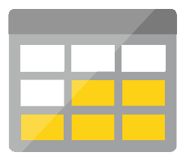
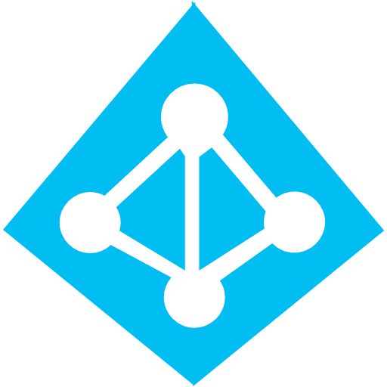
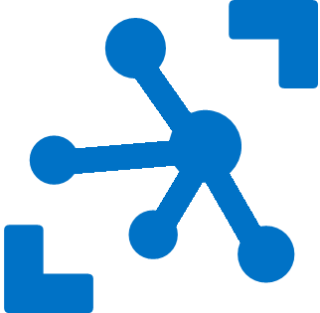

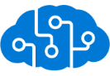
Serverless application platform components
Development
Platform
IDE support
Functions
Logic Apps
Event Grid
Execute your code based on events you specify
Design workflows and orchestrate processes
Manage all events that can trigger code or logic
Integrated DevOps
Local Development
Monitoring
Database
Storage
Security
IoT
Analytics
Intelligence
Visual Debug History
Notes:
Lets talk about what really makes up MSFT’s Serverless platform: At the center of the Serverless platform, is our compute offerings: Azure Functions and Azure Logic Apps. Azure Functions is an event based Serverless compute experience that helps you accelerate your development. Logic Apps is a powerful orchestration tool. It enables building a Serverless app in minutes – by orchestrating multiple functions using a visual workflow tool.
Say you have your apps up and running using Serverless. Congratulations! You now need to collect intelligence from different apps across platforms to take actions upon. There are a few essential components which we think are core to building Serverless applications are:
Data/ Storage –Functions has triggers and bindings with Azure document DB and Azure Blob storage
** Triggers: Triggers are event responses used to trigger your custom code. They allow you to respond to events across the Azure platform or on premise.
** Bindings: Bindings represent the necessary meta data used to connect your code to the desired trigger or associated input or output data.
Messaging such as queues and topics using Azure Service Bus and Azure Event Hubs
Integration – that includes core LOB apps and SaaS apps integration via Azure Logic Apps.
Intelligence on data and sentiment/ predictive analysis using Cognitive services and Machine learning
Conversation as a service – how do we equip developers to build apps that offer an end-to-end experience for their end users – Azure Bot Service offers a Serverless interactive bot experience.
More, developers are spending more time writing code that allows them to add huge business impact with Serverless. MSFT offers numerous development tools such as IDE Support for Visual Studio in functions and Logic Apps, enables local development (vs web browser coding environment), visual debugging capability, all with your tools of choice.
Lastly, I also want to highlight top scenarios and use cases for Serverless:
Real-time Stream analytics: Customers can use Functions to feed real-time streams of data from application tracking into structured data and store it in SQL online.
SaaS event processing: Customers can use Functions and Logic Apps to analyze data from an excel file in Onedrive and perform validation, filtration, sorting and convert data into consumable business charts
Web app architecture: Used a lot in creating targeted marketing collaterals – when a customer clicks on a webpage, it triggers a webhook, that uses a function to create an ad that matches the customer profile and displays a completed webpage.
Real-time bot messaging: When customers send a message to a chatbox, Functions calls Cortana analytics to generate appropriate answers and sends a response back.
//from before: Customers have different paths to build a Serverless app – start by building the distributed application components using functions by leveraging the numerous templates and declarative bindings Or
Start with the workflow and orchestration of Serverless application using Azure Logic Apps. The visual designer enables developers to quickly and easily author, edit and visualize orchestration of multiple functions and workflow.

Slide 31
Scenarios for Serverless
Anything that needs to respond to events
Real-time stream processing
Timer-based processing
Millions of devices feed into Stream Analytics
Transform to structured data
Store data in SQL DB
Every 15 minutes
Find and clean invalid data
Clean table
Backends (Mobile/IoT/Web)
Real-time bot messaging
?
...
Photo taken and WebHook called
Stores in blob storage
Produces scaled images
Message sent to Chatbot
Chatbot sends
response
Cortana Analytics answers questions
Notes:
So what kind of apps and scenarios can be built using serverless technologies? This is not a trick question because I have already given you the answer.
Anything where there is need to run some code or logic in response to an event. You will notice that this is a very broad definition and covers a vast array of scenarios. So let me provide some examples:
Real-time stream processing: IoT devices sending data that needs to be analyzed, enriched and archived somewhere. This is best done using serverless functions which can be spun up on demand, because you don’t know when the data is going to come in and how much data is going to come in. So, you don’t necessarily want to build your own infrastructure for peak capacity.
Almost every organization needs to run some regular tasks like de-duplication of database entries at the end of every day or collecting logs at the end of every week. Such tasks that need to be run only at specific times and only for a few seconds each time, don’t call for dedicated infrastructure. They are best left to serverless solutions.
Building backends for your mobile, IoT or even web apps is also a popular use-case for serverless architectures: In this diagram you see a mobile app sending an image to a function which stores it in Azure Storage. This action triggers another function which creates multiples thumbnails out of the original image. Being able to perform these action in a serverless manner, takes away the burden of the mobile developer from worrying about the backend.
Bots are all the new rage: Automated response systems receiving a customer request is an event. Building intelligent bots for such scenarios using serverless technology is again a great example where the focus needs to be on logic instead of infrastructure.
These are only some of the many examples which fit well with serverless.

Slide 32


Thank You!

